Slide 1
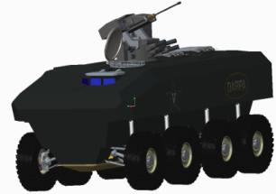
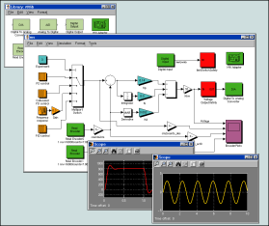
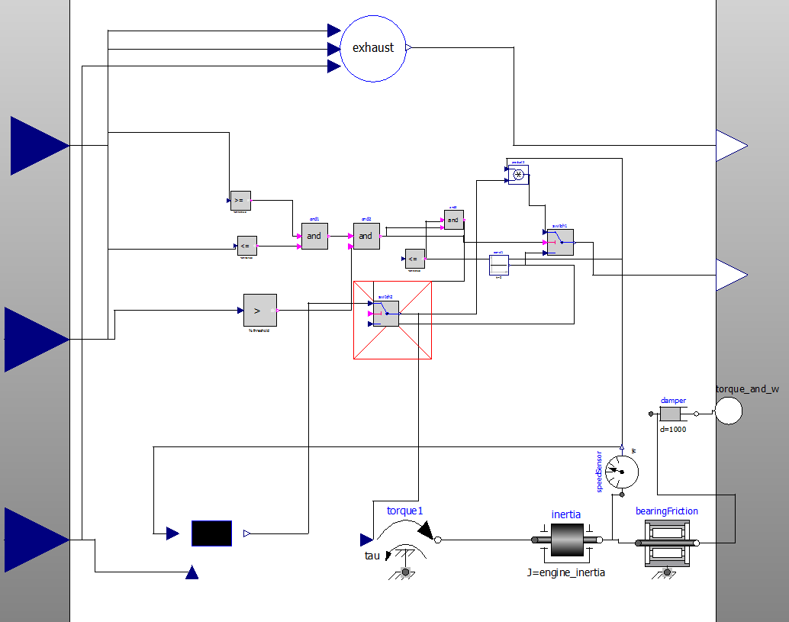
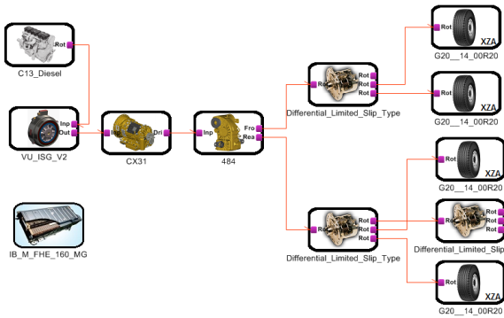
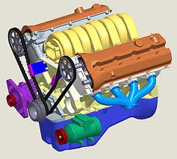
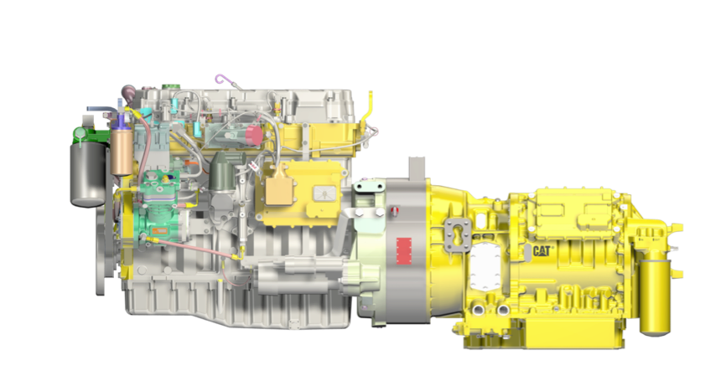
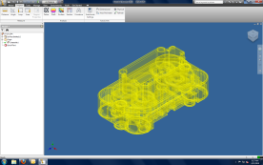
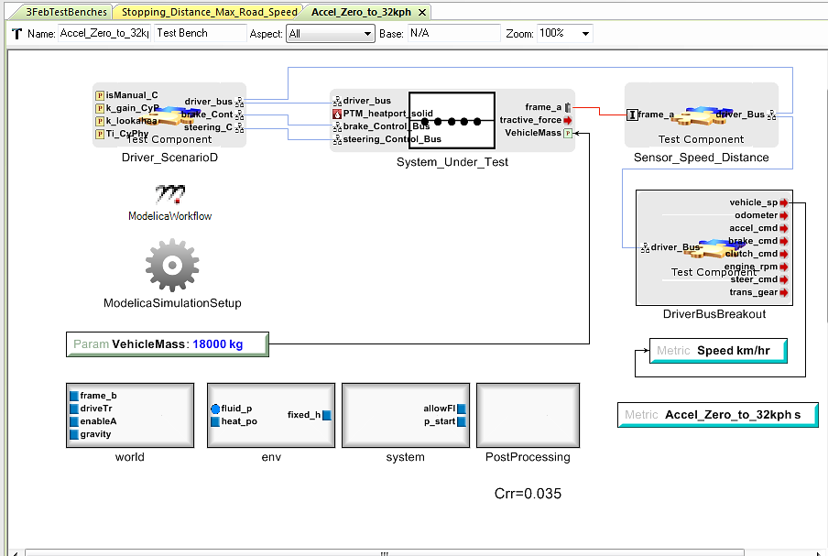
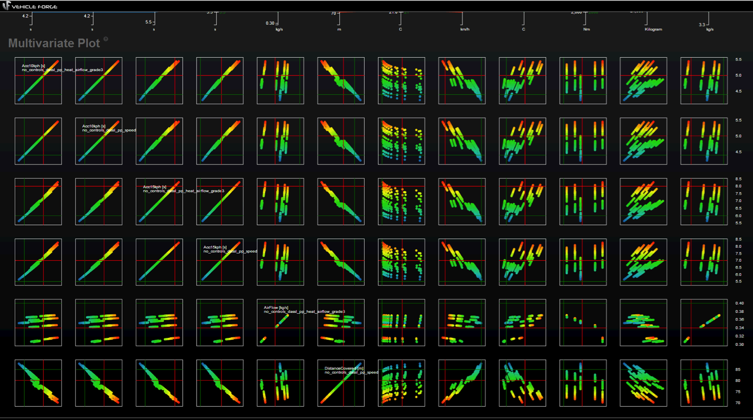

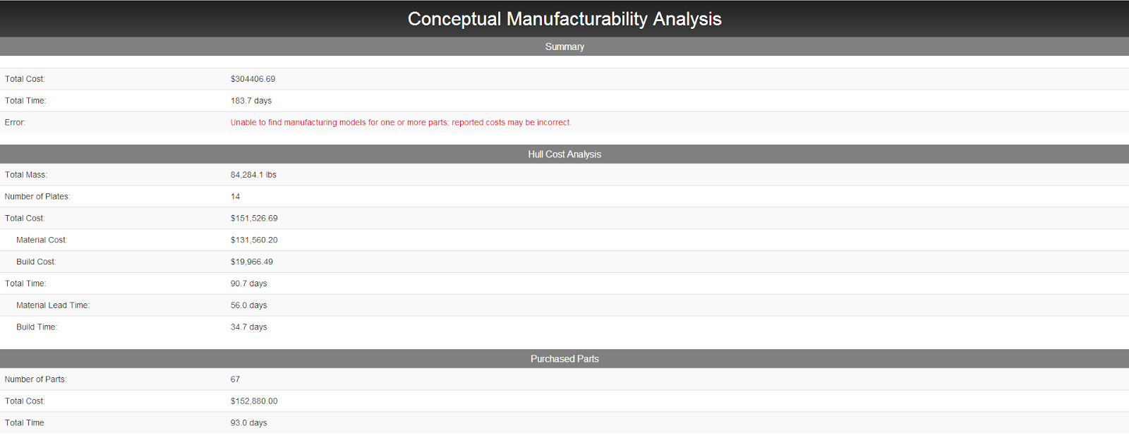
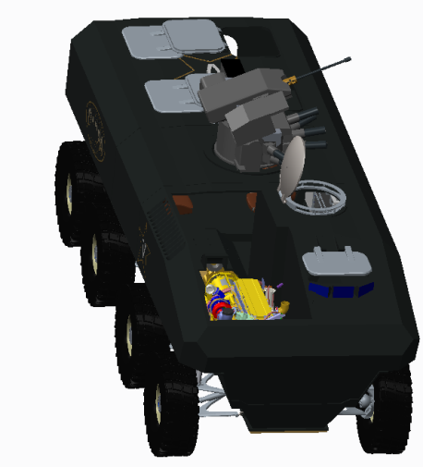
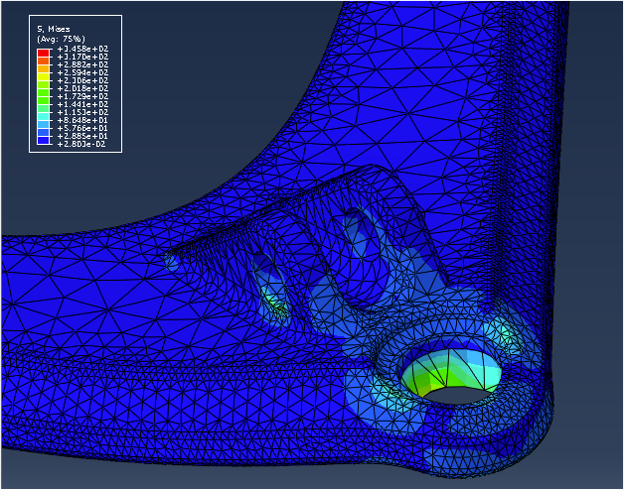
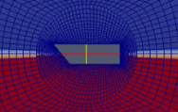
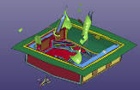
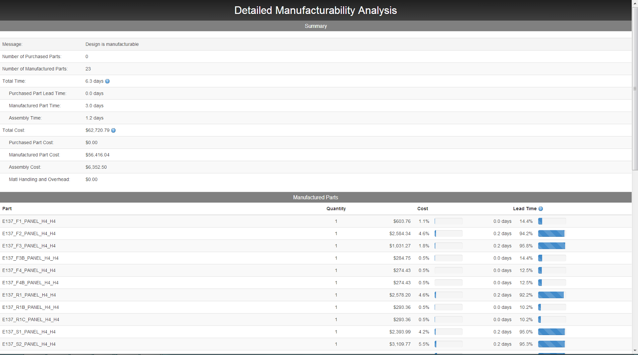

OpenMETA Design Space, Design Modeling, and Analysis
Cyber Physical Modeling (CyPhy)
Derived
Requirements
Stakeholders/
End-Users
Multi-Domain Component Model Libraries
CAD Tool Integration
META
Link
Requirements
Requirements
Requirements
Test Benches
Computed
Design Metrics
Model Composition and Analysis
Dynamics Simulation-Based Performance Analysis
Low Fidelity Manufacturability
Generated CAD Model
Structural FEA Analysis
CFD Analysis
Blast/
Penetration
Analysis
Detailed Manufacturing Analysis
Data Visualization
MAUF Trades Exploration

Slide 2
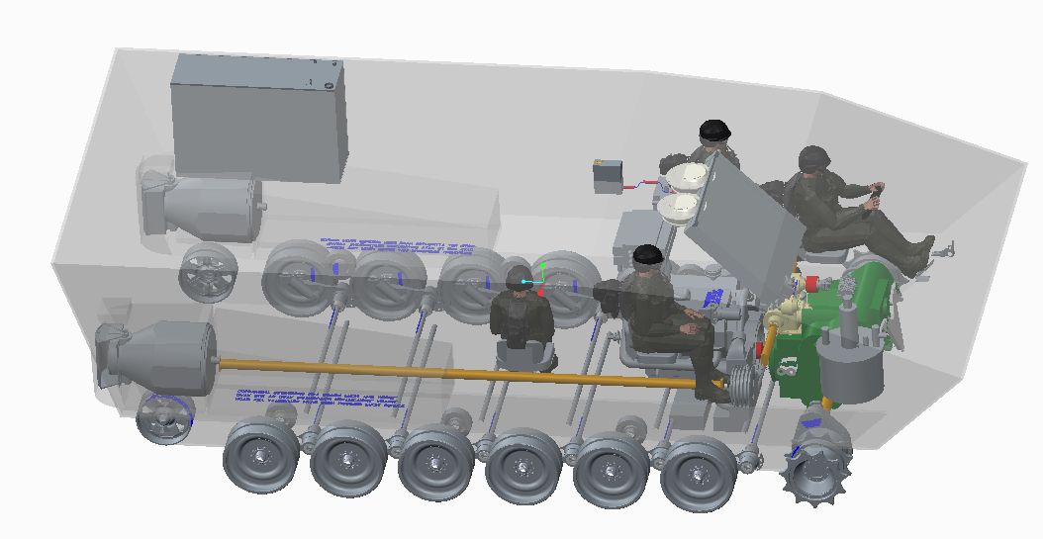
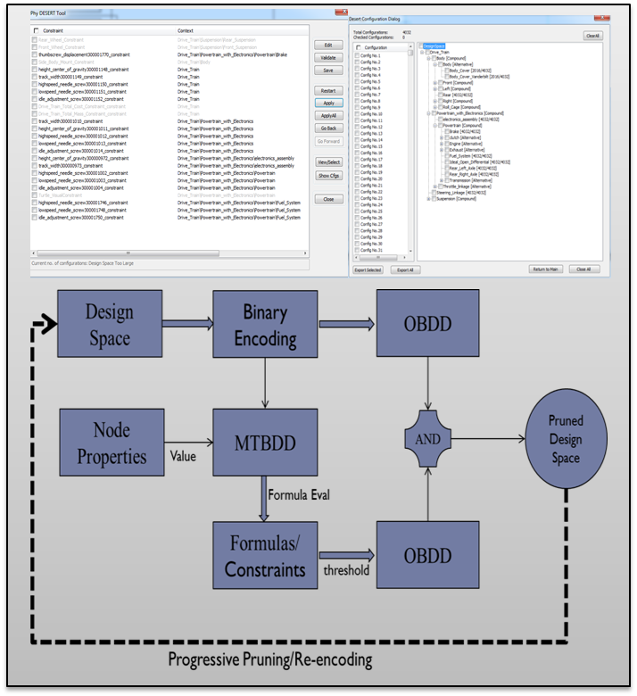
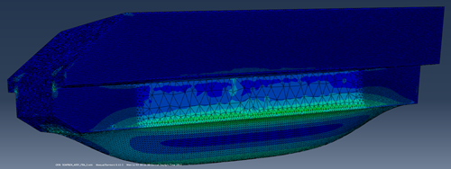
Multi-Domain Component Model Libraries
Component/
(Sub)System Libraries
Design Space and Design Modeling
Cyber Physical Modeling Language
CyPhy/GME
CAD Tool
(PTC/Creo – currently)
META-Link
Stakeholders/
End-Users
Derived
Reqt.
Custom Components/
Sub-Systems
Synchronized 2D-3D Co-Design
Environment
Requirements
Testbenches
Requirements
Requirements
Model and Analysis Composition Tools
Computed Design Metrics
Static Constraint based DSE
Dynamics Simulation based Performance Analysis
Low Fidelity Manufacturability
CAD Geometry Analysis
Structural FEA Analysis
CFD Analysis
Blast/
Penetration
Analysis
Detailed Manufacturing Analysis
10⁶
Design Detail/
Analysis Fidelity
Design Space
Data Visualization
MAUF Trades Exploration
10¹

